Slide 1
Stat 426 machine learning final project
Cameron Page

Slide 2


Slide 4

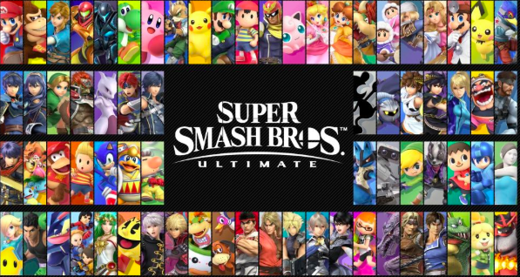
Who is the best?

Slide 5
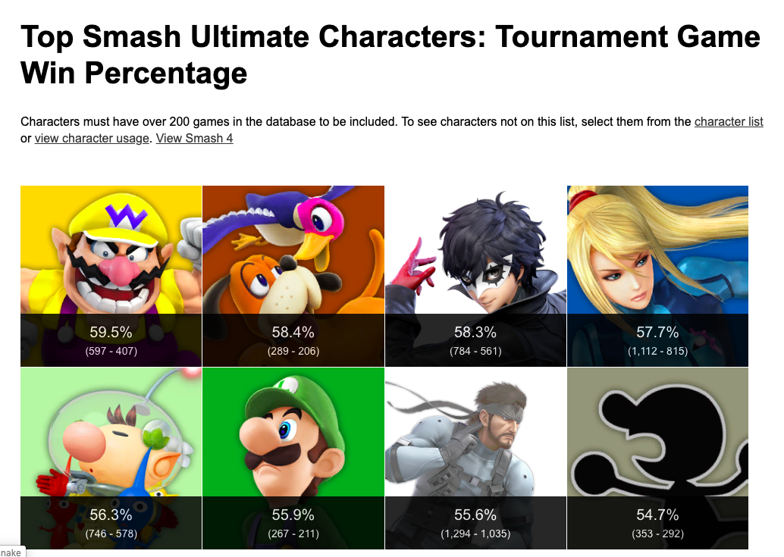
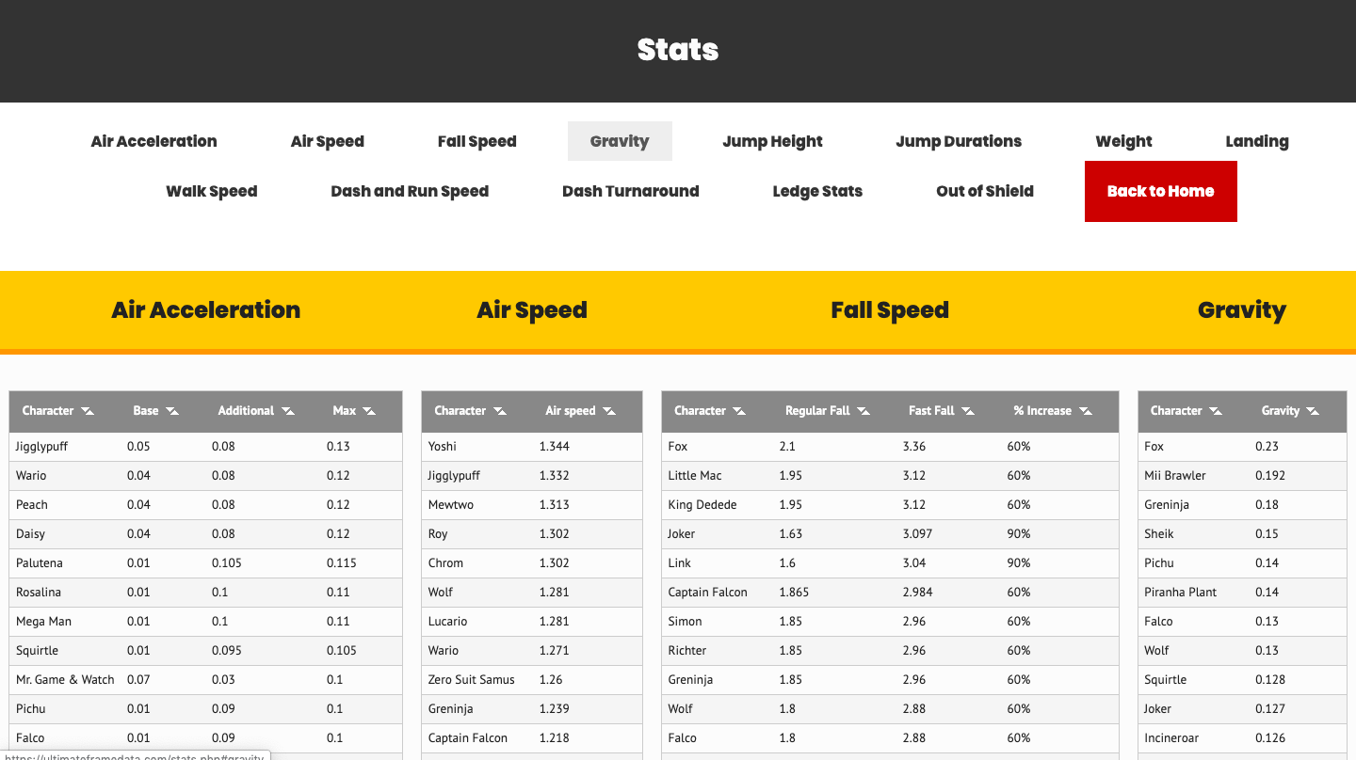
Data collection
https://ssbworld.com/characters/win-percentage/
https://ultimateframedata.com/stats.php

Slide 6
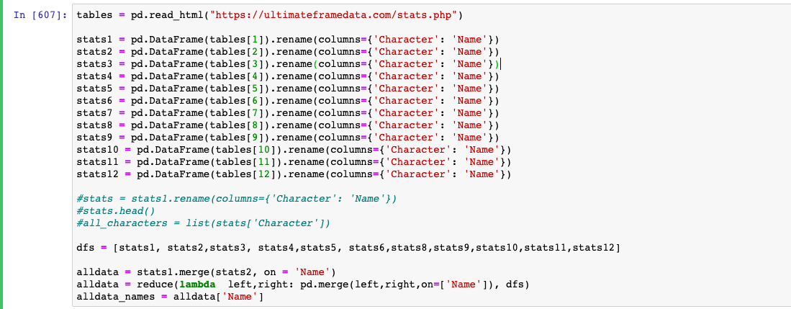
Gathering data from tables

Slide 7
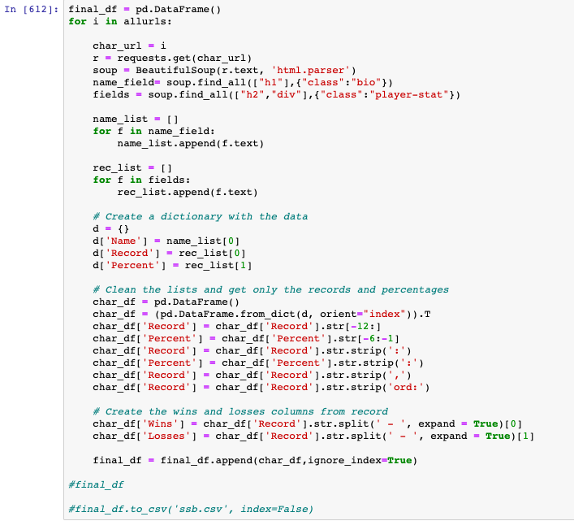
Gathering messier data

Slide 8
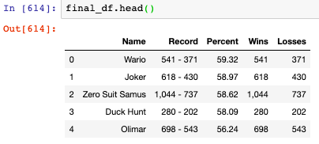
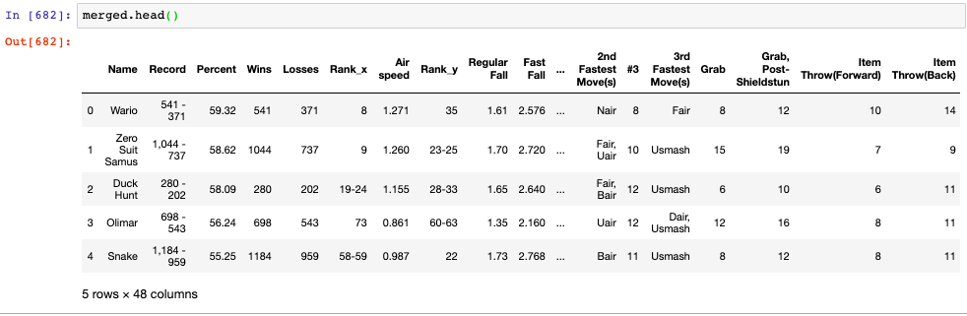

Slide 9
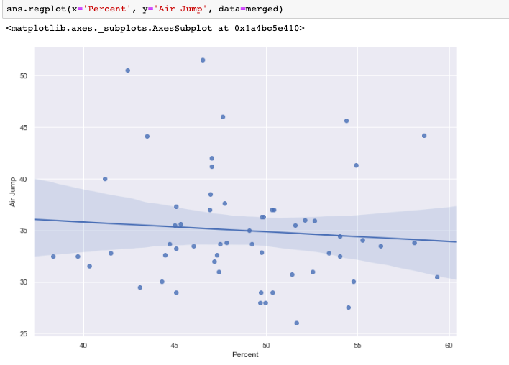
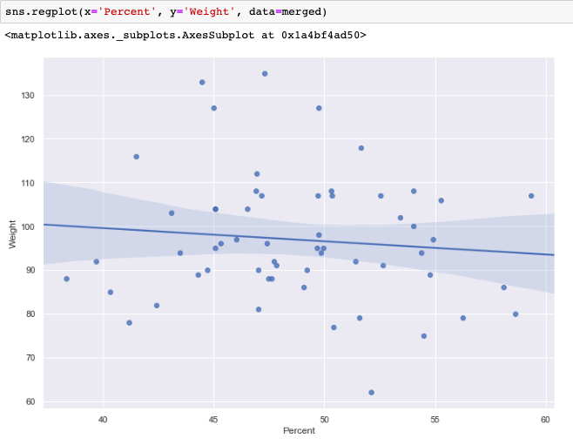
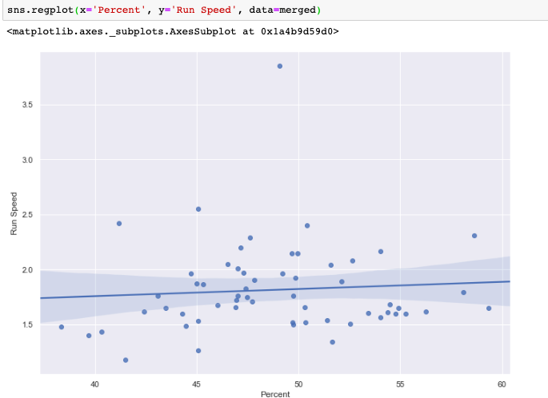
Regression plots
Run Speed
vs.
Percent
Air Jump
vs.
Percent
Not very significant
Weight
vs.
Percent

Slide 10
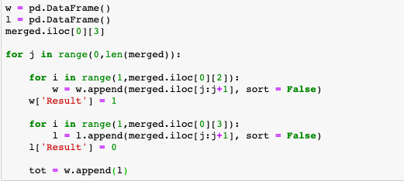
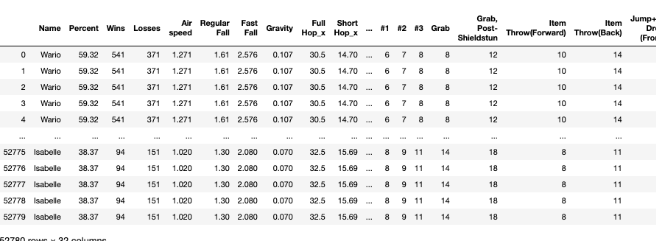

Slide 11
Machine learning models
Logistic Regression
Random Forest
Linear Regression

Slide 12
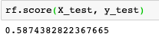
Machine learning models
Logistic Regression
Random Forest
Linear Regression

Slide 13
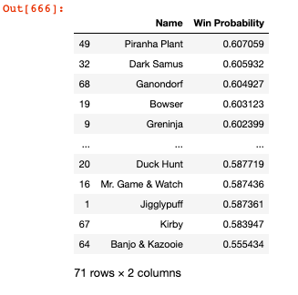
Win probabilities

Slide 14
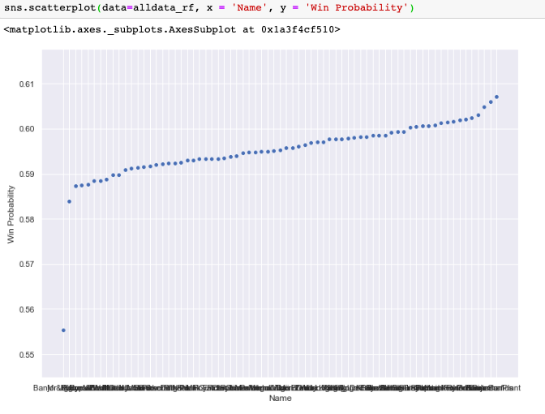

Slide 15
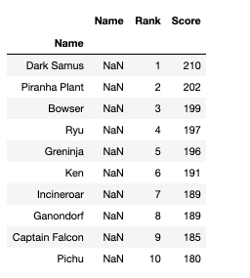
Scores
Scores were given based off a calculation from all the models

Slide 16
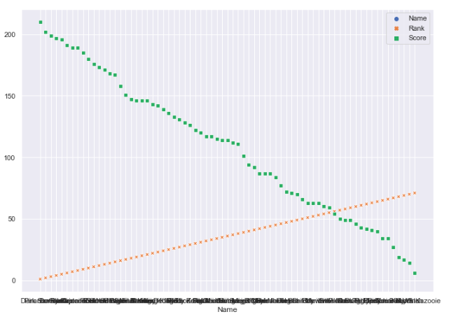

Slide 17
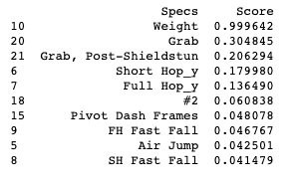
Which features are most important?

Slide 18
Is there a best player?
Results showed that there is not really a best player, considering how close the winning probabilities were to one another.

Slide 19
References
https://www.nintendo.co.uk/Games/Nintendo-Switch/Super-Smash-Bros-Ultimate-1395713.html
https://www.gamesradar.com/super-smash-bros-ultimate-unlock-characters/
https://ssbworld.com/characters/win-percentage/
https://ultimateframedata.com/stats.php

